Slide 1
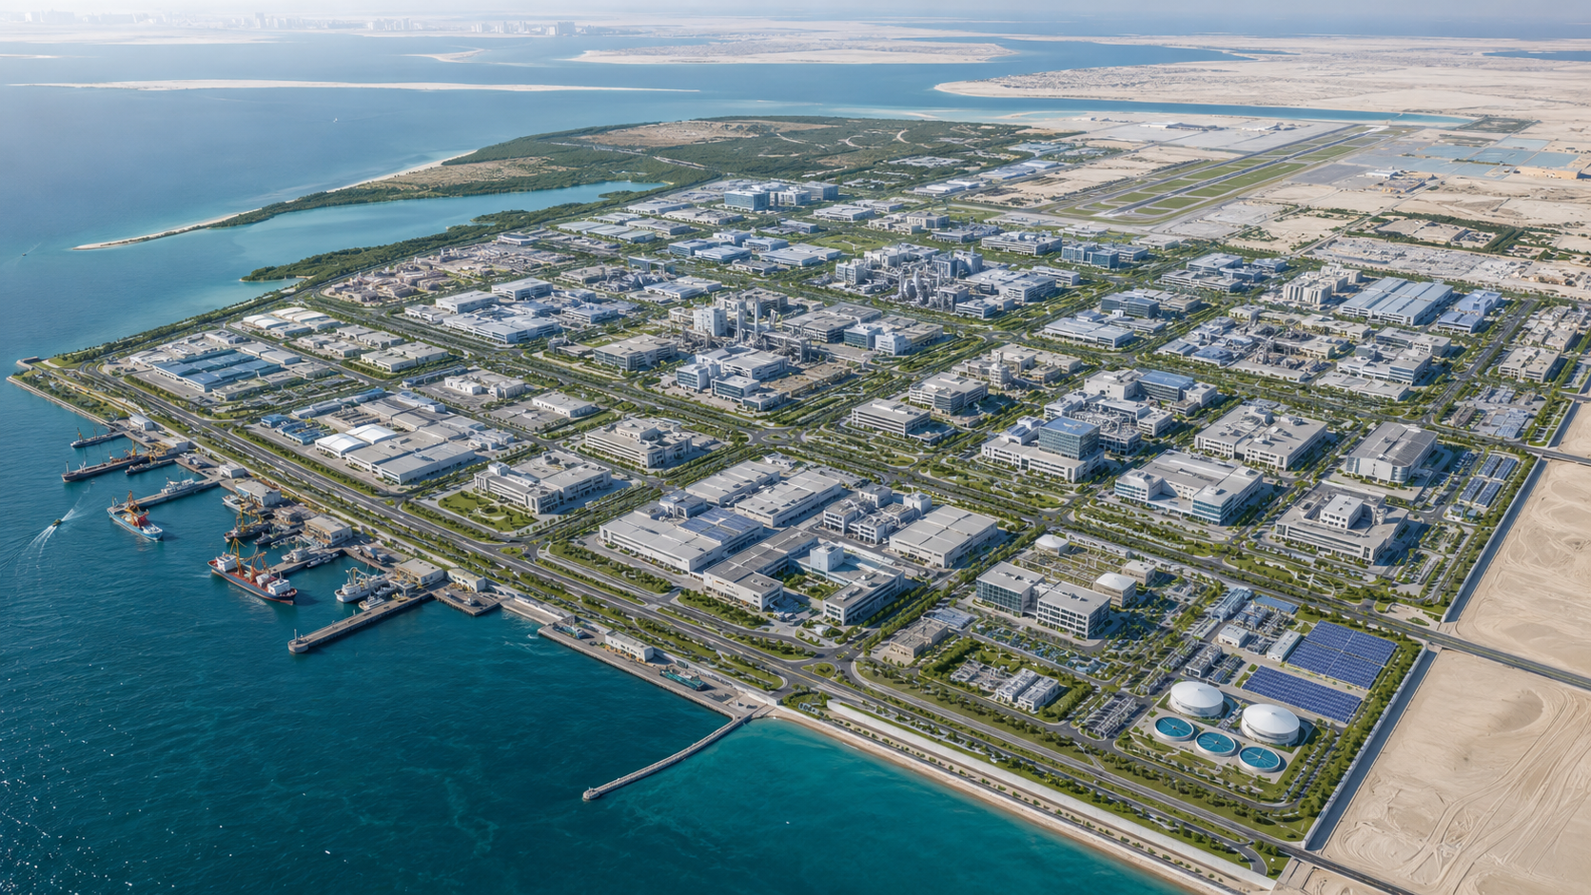
ADPIC
Abu Dhabi Pharmaceutical
Industrial Corporation
Government Presentation | Integrated Pharmaceutical Industrial Zone
25 km² coastal industrial zone
Up to 1,000 factories & companies
Sea + air export corridor
Manufacture in Abu Dhabi. Supply the World.
Notes:
Official alignment sources used in the deck: MoIAT Operation 300Bn, Abu Dhabi Industrial Strategy, Emirates Drug Establishment, MOHAP GS&DP guidelines.

Slide 2

1. Strategic Case for Abu Dhabi
A pharma industrial platform aligned with national industrial growth and medicine security.
1
Industrial diversification
Adds pharma manufacturing, exports and advanced technology to Abu Dhabi’s industrial base.
2
Healthcare security
Builds resilient supply of essential generic medicines for UAE and partner governments.
3
Global trade position
Connects manufacturing, wholesale medicine, raw materials, seaport and air cargo in one zone.
4
Government-to-government supply
Creates a platform for long-term medicine supply agreements with target countries.
ADPIC | Abu Dhabi Pharmaceutical Industrial Corporation
02
Notes:
MoIAT Operation 300Bn targets increasing industry contribution to GDP to AED300bn by 2031; Abu Dhabi Industrial Strategy targets pharmaceuticals among focus sectors.

Slide 3
2. Project Vision
A complete pharmaceutical ecosystem — not only an industrial estate.
ADPIC will give manufacturers a complete operating environment:
Core promise
A factory comes to Abu Dhabi and receives the full ecosystem to manufacture, buy inputs, test quality, sell in bulk and export globally.
Land & permissions
Raw materials
Quality testing
Wholesale buyers
Seaport & airport
Government supply channels
Manufacturers focus on production
Distributors handle global market reach
Government signs long-term medicine supply programs
ADPIC | Abu Dhabi Pharmaceutical Industrial Corporation
03

Slide 4
3. 25 km² Coastal Master Zone
A controlled industrial and trade ecosystem with direct sea and air access.
Planning principle
Manufacturing Clusters
Raw Material Market
Wholesale Medicine Market
Cluster factories by product category and safety classification
Keep raw materials, labs and warehousing close to production
Central Labs / QA
Cold + Dry Warehouses
Government Service Center
Separate truck, buyer, employee and visitor movement
Reserve expansion corridors for future capacity
Seaport Corridor
Airport / Air Cargo
Illustrative planning view
ADPIC | Abu Dhabi Pharmaceutical Industrial Corporation
04

Slide 5
4. Industrial Clusters & Specialization
Specialization reduces market confusion and strengthens buyer confidence.
Target cluster examples
Rule of the zone
Diabetes medicines
Each manufacturer and distributor should have a clear category. General trading in all categories requires special approval.
Blood pressure & heart
Antibiotics
Injections & IV fluids
Pediatric medicines
Buyer knows exactly where to go.
Herbal / natural products
ADPIC | Abu Dhabi Pharmaceutical Industrial Corporation
05

Slide 6
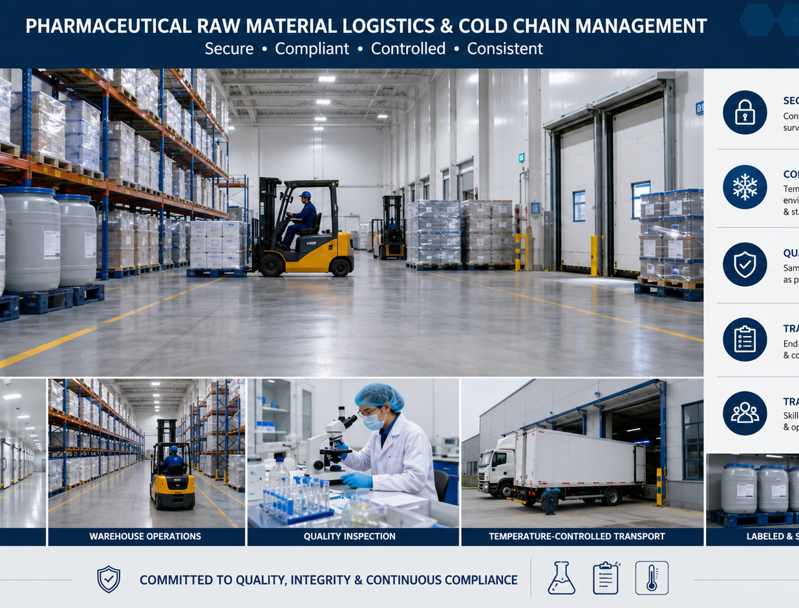
5. Raw Material Supply Market
Inputs available inside the zone — controlled, tested and traceable.
Why it matters
Reduces procurement complexity for factories
Creates regulated traceability from material to batch
Supports cold-chain and hazardous material controls
Builds confidence for international buyers and regulators
SOP control points: supplier registration, certificate review, sample testing, approved storage, transaction logging, recall readiness.
ADPIC | Abu Dhabi Pharmaceutical Industrial Corporation
06

Slide 7
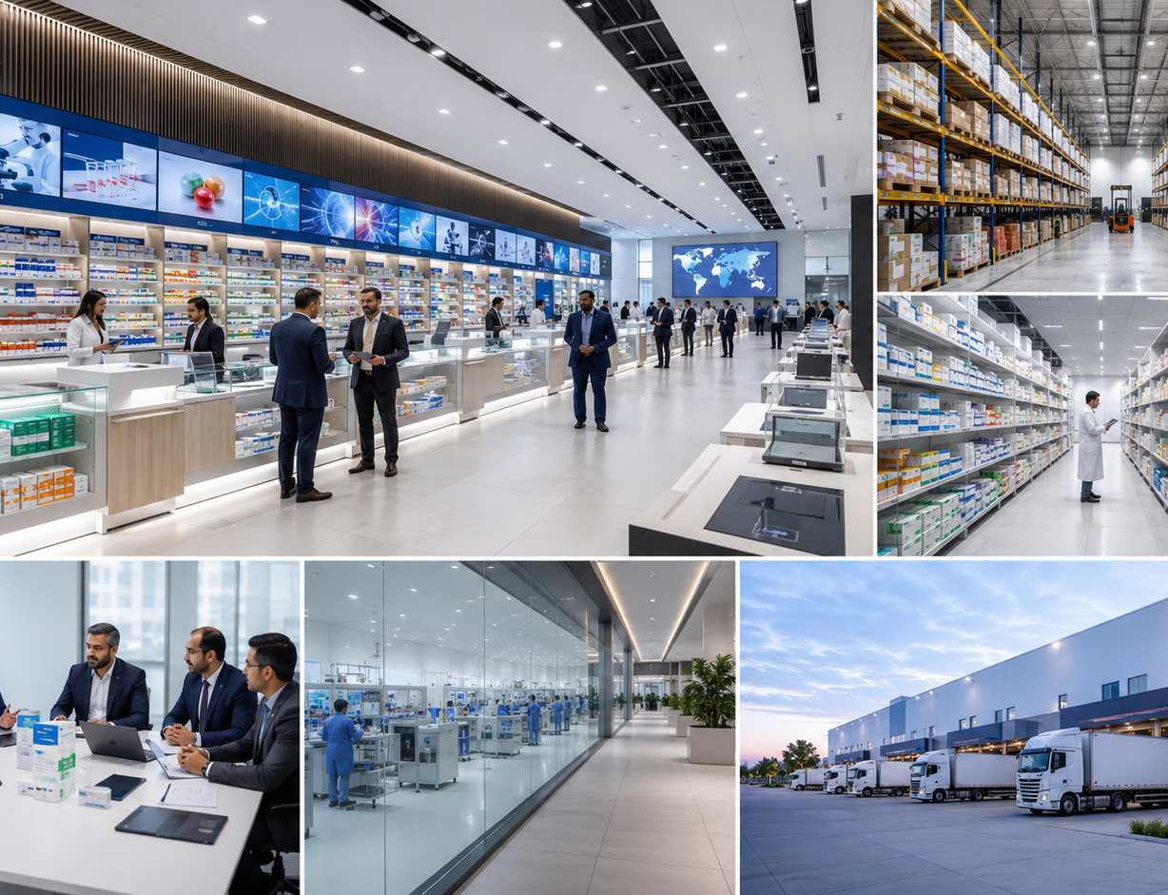
6. Wholesale Medicine Market
A controlled buying and selling hub connected directly to factories and export logistics.
Buyer journey
1
Enter approved trade access
International buyer, government delegation or distributor registers.
2
Go to specialized category
Diabetes, injections, antibiotics, pediatric medicines and other focused counters.
3
Purchase & export
Factory supply, quality certificate, documents and shipment prepared in one workflow.
Result: factories do not need to chase buyers; buyers do not need to search globally.
ADPIC | Abu Dhabi Pharmaceutical Industrial Corporation
07

Slide 8

7. Sea + Air Logistics Engine
Pharma logistics designed for speed, control and global supply.
Two export modes
1
Sea freight
Bulk exports, containers, raw material imports, regional and global shipments.
2
Air cargo
Urgent medicines, high-value shipments, cold chain and emergency government supply.
3
Digital tracking
Batch, temperature, shipment status and delivery confirmation linked in one platform.
ADPIC | Abu Dhabi Pharmaceutical Industrial Corporation
08

Slide 9
8. Government-Supported Business Model
Core infrastructure from Abu Dhabi; industrial operators come to manufacture and trade.
Government provides
Land & zoning
Infrastructure
One-stop approvals
Ports / air cargo link
Promotion & G2G access
Industry operates
Factories
Raw material supply
Wholesale distribution
Packaging
Logistics services
Market receives
Affordable generic medicines
Reliable supply
Quality documentation
Export readiness
Long-term contracts
ADPIC value: the ecosystem removes the friction between licensing, production, inputs, buyers and export logistics.
ADPIC | Abu Dhabi Pharmaceutical Industrial Corporation
09

Slide 10
9. Regulatory & Compliance Architecture
A pharma zone must be fast, but never informal — regulated quality is the asset.
Facility licensing
Product registration
Manufacturing and pharmaceutical facility approvals
Market authorization and product-specific permissions
GMP / GDP
Quality labs
Good manufacturing, storage and distribution practices
Testing, batch control, stability and microbiology
Customs & security
Pharmacovigilance
Controlled trade access, export documents and inspection
Complaint, recall and post-market systems
Recommended wording: “Fast Business Entry / Special Trade Access System” — subject to sovereign immigration, customs and security approvals.
ADPIC | Abu Dhabi Pharmaceutical Industrial Corporation
10
Notes:
EDE regulates pharmaceutical testing, drug approval and registration, manufacturing, market authorization, pharmacovigilance, control and inspection. MOHAP GS&DP guidelines cover storage and logistics.

Slide 11
10. SOP Operating Model
Standard operating procedures from onboarding to export and recall readiness.
1
2
3
4
5
6
7
Company onboarding
Land / factory allocation
Raw material control
Production & QA
Wholesale sale
Export & logistics
Complaints / recall
SOP governance
PMO owns SOP roadmap
Regulatory Affairs updates compliance SOPs
Quality Department audits execution
Digital platform records evidence
ADPIC | Abu Dhabi Pharmaceutical Industrial Corporation
11

Slide 12
11. Project Management Roadmap
Phase delivery reduces risk and allows early pilot operation.
0
1
2
3
4
5
Government Approval
Master Plan + Regulation
Core Infrastructure
Pilot Zone
Expansion
Global Operation
3–6 months
6–12 months
18–30 months
12–18 months
3–5 years
5–8 years
Pilot objective
Launch first 50–100 factories and companies, test SOPs, start raw material and wholesale market operations, and sign first export / government supply agreements.
ADPIC | Abu Dhabi Pharmaceutical Industrial Corporation
12

Slide 13
12. High-Level BOQ Structure
Initial planning packages for feasibility and government budgeting.
A
Studies + Master Plan
B
Land + Infrastructure
C
Factory Zones
D
Labs + QA Center
E
Raw Material Market
F
Wholesale Market
G
Seaport Facility
H
Air Cargo Hub
I
Security + Safety
J
Digital Platform
Final BOQ requires engineering design, soil study, EIA, utility load calculations, GMP/GDP requirements, and port/aviation approvals.
ADPIC | Abu Dhabi Pharmaceutical Industrial Corporation
13

Slide 14
13. Economic Value Proposition
A strategic platform for exports, jobs, local value and medicine security.
1,000
25 km²
50–100
G2G
target factories / companies over phased rollout
initial proposed coastal land area
pilot companies in early operation
long-term supply agreements with governments
Revenue channels
Industrial leases
Warehousing & cold storage
Lab testing and certification
Port and air cargo handling
Digital marketplace fees
Training and regulatory services
ADPIC | Abu Dhabi Pharmaceutical Industrial Corporation
14

Slide 15
14. Target Markets & Government Supply
From Abu Dhabi to high-demand medicine markets.
Agreement model
Target regions
Define country medicine demand
1
India
China
2
Match demand with ADPIC factories
Russia
Africa
3
Agree price, quantity and delivery plan
Central Asia
GCC / Middle East
4
Execute annual supply with quality certificates
ADPIC | Abu Dhabi Pharmaceutical Industrial Corporation
15

Slide 16
15. Key Risks & Controls
Risk control must be designed into governance from day one.
Regulatory delay
One-stop approval center
High infrastructure cost
Phased delivery + QS validation
Quality failure
Central QA/QC + audits
Port/airport delay
Temporary link to existing logistics
Low manufacturer attraction
Global campaign + incentives
Export country variation
International registration team
ADPIC | Abu Dhabi Pharmaceutical Industrial Corporation
16

Slide 17
16. Recommended Government Decisions
Actions needed to move from concept to bankable feasibility and implementation.
1
Approve concept
Recognize ADPIC as a strategic pharmaceutical industrial initiative.
2
Form steering committee
Include industry, health, economy, customs, ports, aviation and security stakeholders.
3
Appoint master planner
Prepare full land plan, feasibility, EIA, BOQ and delivery model.
4
Launch pilot package
Start with 50–100 companies and early raw material / wholesale markets.
5
Open international engagement
Invite manufacturers, suppliers, distributors and governments to MoUs.
ADPIC | Abu Dhabi Pharmaceutical Industrial Corporation
17

Slide 18
17. Official Strategic Alignment
The proposal is designed to complement UAE and Abu Dhabi industrial priorities.
Public-source alignment used for this presentation
Operation 300Bn — MoIAT strategy to raise industry contribution to GDP from AED133bn to AED300bn by 2031.
Abu Dhabi Industrial Strategy — AED10bn investment target to more than double manufacturing to AED172bn by 2031.
ADIS focus sectors — Pharmaceuticals listed among Abu Dhabi targeted manufacturing sectors.
Emirates Drug Establishment — Regulatory role includes drug approval, registration, manufacturing, market authorization, testing and inspection.
MOHAP GS&DP — Guidance for pharmaceutical storage and distribution practices.
Closing proposition: ADPIC can transform Abu Dhabi into a global generic medicine manufacturing, trading and export hub.
ADPIC | Abu Dhabi Pharmaceutical Industrial Corporation
18
Notes:
Sources: https://moiat.gov.ae/en/about-us/about-the-strategy; https://www.abudhabi.gov.ae/en/programmes/abu-dhabi-industrial-strategy; https://idb.added.gov.ae/en/ADIS; https://www.ede.gov.ae/en/home; https://mohap.gov.ae/documents/20117/1212145/moh+uae+good+storage+practices+english-664.pdf/122d51d0-cf40-25df-1303-e88cddbe8926

